Slide 1
PEP Input Class
Presented By
Kanika Sharma

Slide 2
Topics to be covered…
Writing a string,
Processing of string,
Type of functions,
call by value concept
Pointers and functions,

Slide 3
Working with strings
String class stores the characters as a sequence of bytes with the functionality of allowing access to the single-byte character.

Slide 4
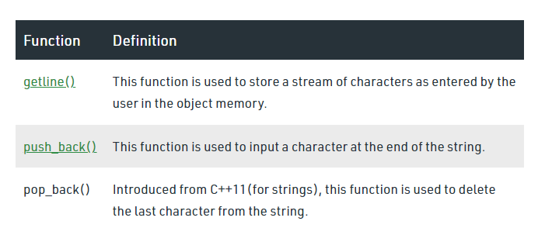
Inbuilt functions in string
#include <iostream>
#include <string> // for string class
using namespace std;
int main()
{
string str;
getline(cin, str);
cout << "The initial string is : ";
cout << str << endl;
str.push_back('s');
cout << "The string after push_back operation is : ";
cout << str << endl;
str.pop_back();
cout << "The string after pop_back operation is : ";
cout << str << endl;
return 0;
}

Slide 5
Arrays of strings
Using Pointers
Using 2-D Array
Using the Sting Class

Slide 6
String initialization
const char* colour[4]= { “xy", “pq", “rz", “tp" };
char colour[4][10] = { “xy", “pq", “rz", “tp" };
string colour[4] = { “xy", “pq", “rz", “tp" };

Slide 7
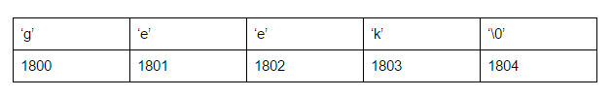
Pointers and strings
const char * ptr = "geek";
As pointers and arrays behave in the same way in expressions, ptr can be used to access the characters of string literal. For example:
char x = *(ptr+3);
char y = ptr[3];

Slide 8
Functions
A function is a set of statements that take inputs, do some specific computation and produces output.

Slide 9
Functions
Functions help us in reducing code redundancy.
Functions make code modular.
Functions provide abstraction.
Syntax:
return_type function_name([ arg1_type arg1_name, ... ]) { code }

Slide 10
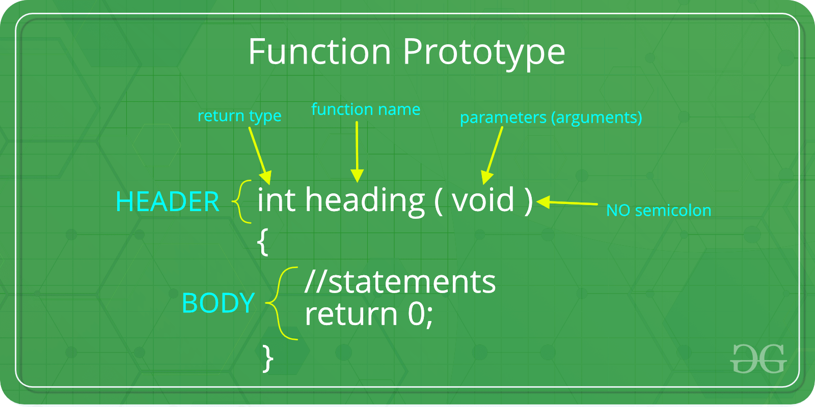
Function prototype

Slide 11
Main function
1.
// Without Parameters
int main()
{
...
return 0;
}
2.
// With Parameters
int main(int argc, char * const argv[])
{
...
return 0;
}

Slide 12
Functions in C++
Functions with default arguments
Inline functions

Slide 13
Calling a function
Call by value
Call by reference

Slide 14
Passing array to functions
return_type function(type arrayname[])
return_type function(type arrayname[SIZE])
return_type function(type *arrayname)

Slide 15
Example 1
#include<iostream>
using namespace std;
int sum(int arr[])
{
int s=0;
for(int i=0;i<3;i++)
{
s=s+arr[i];
}
return s;
}
int main()
{
int arr[5]={1,2,3,4,5};
cout<<sum(arr);
return 0;
}

Slide 16
Example 2
#include<iostream>
using namespace std;
int sum(int arr[5])
{
int s=0;
for(int i=0;i<3;i++)
{
s=s+arr[i];
}
return s;
}
int main()
{
int arr[5]={1,2,3,4,5};
cout<<sum(arr);
return 0;
}

Slide 17
Example 3:
#include<iostream>
using namespace std;
int sum(int *arr)
{
int s=0;
for(int i=0;i<3;i++)
{
s=s+arr[i];
}
return s;
}
int main()
{
int arr[5]={1,2,3,4,5};
cout<<sum(arr);
return 0;
}

Slide 18
Returning array from function
int * Function_name() {
//some statements;
return array_type;
}

Slide 19
Complete the code
Program to display array element
Function name-> display
Returning an array
Accepting array as an argument

Slide 20
Complete the code
#include<iostream>
using namespace std;
int display(int arr)
{
return ;
}
int main()
{
return 0;
}
Correct this code
Main method part is missing

Slide 21
Example
#include<iostream>
using namespace std;
int *display(int *arr)
{
return arr;
}
int main()
{
int arr[5]={1,2,3,4,5};
int *ptr=display(arr);
for(int i=0;i<5;i++,*ptr++)
{
cout<<*ptr;
}
return 0;
}

Slide 22
MCQ
.How to declare a pointer to a function? a) Int *(fp)() b) Int (*fp)() c) Int * (fp)() d) None

Slide 23
Answer
b

Slide 24
Pointers and functions
#include <iostream>
using namespace std;
void msg(int x)
{
cout<<x;
}
int main()
{
void (*fun_ptr)(int)=&msg;
(*fun_ptr)(10);
return 0;
}

Slide 25
Array of function pointers
int main()
{
void (*fun_ptr_arr[])(int, int) = {add, subtract, multiply};
unsigned int ch, a = 5, b = 10;
cout<<"Enter Choice: 0 for add, 1 for subtract and 2 "
"for multiply";
cin>>ch;
if (ch > 2) return 0;
(*fun_ptr_arr[ch])(a, b);
return 0;
}
#include <iostream>
using namespace std;
void add(int a, int b)
{
cout<<"Addition is "<< a+b;
}
void subtract(int a, int b)
{
cout<<"Subtraction is"<< a-b;
}
void multiply(int a, int b)
{
cout<<"Multiplication is "<< a*b;
}

Slide 26
Correct the code
#include<iostream>
using namespace std;
void maxReplace(int size, int *inputList)
{
int i,sum=0;
for(i=0;i<size;i++)
{
sum += inputList[i];
}
for(i=0;i<size;i++)
{
sum = inputList[i];
}
for(i=0;i<size;i++)
{
cout<<inputList[i]);
}
}
int main()
{
int arr[5]={1,2,3,4,5};
maxReplace(3,arr);
return 0;
}
Desired output:
6 6 6

Slide 27
solution
#include<iostream>
using namespace std;
void maxReplace(int size, int *inputList)
{
int i,sum=0;
for(i=0;i<size;i++)
{
sum += inputList[i];
}
for(i=0;i<size;i++)
{
inputList[i]=sum;
}
for(i=0;i<size;i++)
{
cout<<inputList[i]);
}
}
int main()
{
int arr[5]={1,2,3,4,5};
maxReplace(3,arr);
return 0;
}

Slide 28
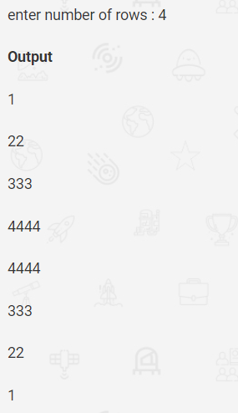
Correct the code
int main()
{
int i,j,n;
cout<<"Enter the number of rows: ";
cin>>n;
for(i=1;i<=n;i=i+1)
{
for(j=1;j<=i;j=j+1)
{
cout<<i;
}
cout<<"\n";
}
for(i=n;i>=1;i=i-1)
{
for(j=1;j<=i;j=j-1)
{
cout<<i;
} }
return 0;}

Slide 29
Solution
int main()
{
int i,j,n;
cout<<"Enter the number of rows: ";
cin>>n;
for(i=1;i<=n;i=i+1)
{
for(j=1;j<=i;j=j+1)
{
cout<<i;
}
cout<<"\n";
}
for(i=n;i>=1;i=i-1)
{
for(j=1;j<=i;j=j+1)
{
cout<<i;
} cout<<“\n”; }
return 0;}

Slide 30
Hands on exercise

Slide 31
Problem 1
Racing Bikers is organising a bike race with N bikers. The initial speed of the ith biker is denoted by H_{i} Km/hr and the acceleration of ith biker as A_{i} Km/Hr2. A biker whose speed is 'L' or more, is considered be a fast biker. The total speed on the track for every hour is calculated by adding the speed of each fast biker in that hour. When the total speed on the track is 'M' kilometers per hour or more, the safety alarm turns on. Find the minimum number of hours after which the safety alarm will start.
Your Task: You do not need to read input or print anything. Your task is to complete the function buzzTime() which takes N, M, L and array H and array A as input parameters and returns the time when alarm buzzes.
IBM

Slide 32
Problem 2
Given a string A and a dictionary of n words B, find out if A can be segmented into a space-separated sequence of dictionary words.
Note: From the dictionary B each word can be taken any number of times and in any order.
Your Task: Complete wordBreak() function which takes a string and list of strings as a parameter and returns 1 if it is possible to break words, else return 0. You don't need to read any input or print any output, it is done by driver code.
Amazon, google

Slide 33
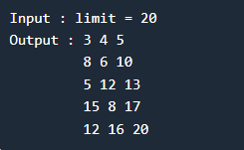
Automata fix
A Pythagorean triplet is a set of three integers a, b and c such that a² + b² = c². Given a limit, generate all Pythagorean Triples with values smaller than given limit.

Slide 34

Solution
An Efficient Solution can print all triplets in O(k) time where k is number of triplets printed. The idea is to use square sum relation of Pythagorean triplet, i.e., addition of squares of a and b is equal to square of c, we can write these number in terms of m and n such that,

Slide 35
Mock Interview
Can we modify the value of constant in C? (Cognizant)
Can we overload main method ? (IBM)
How we can access the element of arr[2][3][4][5][6]? (TCS)
Can you diffentiate between pointer and reference?

Slide 36
Solution
#include<stdio.h>
int main()
{
const int a = 5;
int *b = &a;
(*b)++;
printf("%d",a);
}

Slide 37
Thanks.

